Slide 1
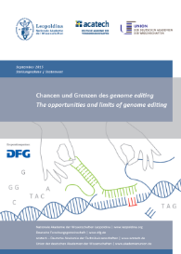
In Retrospect: Summit on Human Gene Editing, Washington 12/2015
The opportunities and limits of genome editing
The new techniques allow efficient, precisely targeted genetic alterations in all living cells and promise high potential for gaining knowledge.
Substantial research is required prior to safe and responsible clinical use.
The German Embryo Protection Act strictly prohibits “the use of an embryo for any purpose other than inducing a pregnancy.” This limits the range of human genome editing research that can be conducted in Germany.
September 2015
www.leopoldina.org/en/publications

Slide 2
Ethical and legal assessment of genome editing in research on human cells (03/2017)
Genome editing research on human embryos and gametes should be pursued in Germany to gain basic knowledge on early embryonic development, which can be a prerequisite for the treatment of genetic disorders.
Application of heritable human genome editing for reproductive purposes should not be permitted until potential risks of unintended adverse consequences have been thoroughly assessed.
Normative evaluation of the risks, unintended outcomes and benefits can only be achieved through biological and pre-clinical research to obtain evidence-based reliable scientific knowledge.
Taking the legislation and moral objections into account a compromise for German scientists would be the use of surplus IVF embryos for research.
This option, however, can only be realized in practice if the German Embryo Protection Act becomes amended.
Ethical and social concerns e.g. prevention, enhancement, access to treatment, social justice, governance are waiting for further discourses.
Working group on human
genome editing
www.leopoldina.org/en/publications

